Slide 1
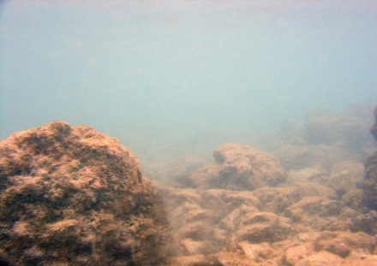
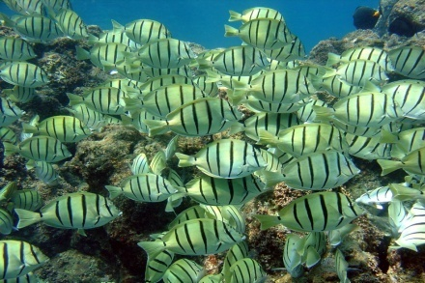
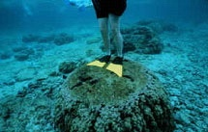
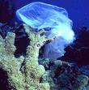
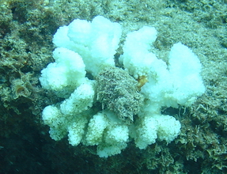
Human Impacts on Our Coral Reefs
Sedimentation
Over-Fishing
Careless Recreation
Pollution
Climate Change
Notes:
This presentation covers topics including sedimentation, over-fishing, careless recreation, and climate change. Each topic has its own overview and focuses on its impacts on coral reefs.

Slide 2
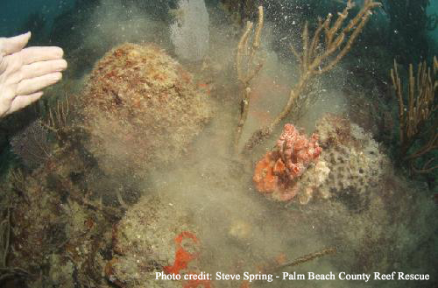
What is sedimentation?
Sedimentation
Sedimentation occurs when sediments found on land (soil, silt, & sand) enter the ocean and cause the water to become very murky
Notes:
Sedimentation refers to a process, where sediment is what actually travels and is deposited somewhere else. Increased sedimentation on coral reefs can alter a reef’s structure - leading to the loss of habitats and species. These changes have serious ecological, environmental, and economic consequences.

Slide 3
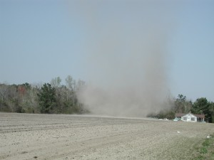
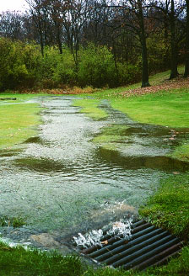
How does sediment travel?
Sedimentation
Wind
Natural Impacts
Runoff
Notes:
Wind picks up sediment and can transport it several miles from its origin. Heavier winds can pick up more sediment and deposit it anywhere. When it rains, sediment travels from the surrounding land and is washed into streams or the ocean. Fast-moving water can pick up, suspend, and move larger particles more easily than slow-moving waters. This is why rivers or the ocean looks muddier during storms.

Slide 4
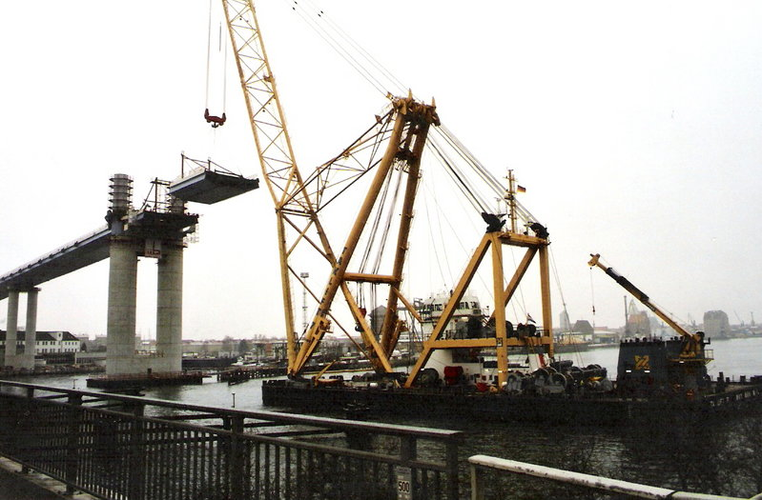
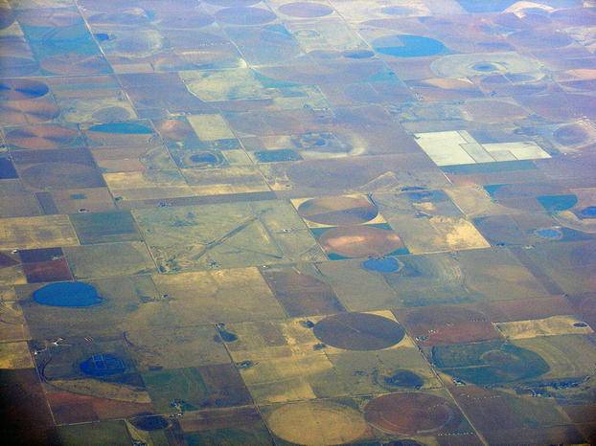
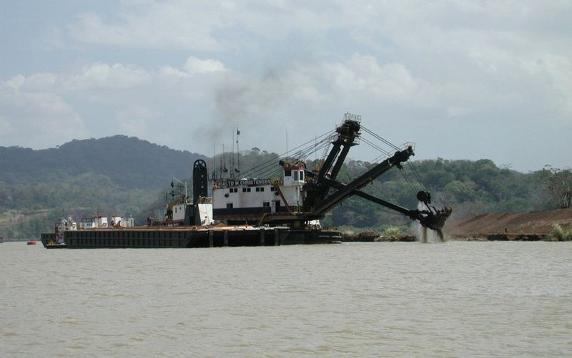
What are human causes of sedimentation?
Clearing land for homes, resorts, & other buildings
Harbor construction
Sedimentation
Agriculture
Dredging
Notes:
Sedimentation often occurs when the surface of the soil or ocean floor is disturbed. When land is cleared for homes, resorts, and agriculture, the sediment is disturbed and can be blown or washed away to other places such as the ocean. Harbor construction and dredging will stir up the ocean floor and suspend sediments in the water.

Slide 5
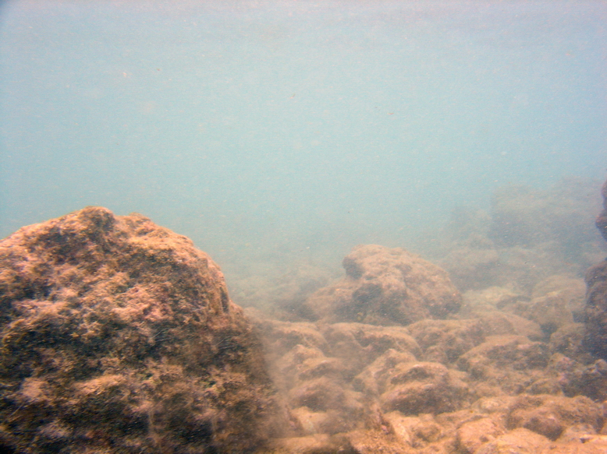
How does sedimentation threaten the coral reef habitat?
Smothering coral when particles settle out
Reducing light availability which reduces coral photosynthesis and growth
Sedimentation increases nutrients which allow algae overgrowth on coral
Sedimentation
Notes:
High sediment loads kill coral in two primary ways. First, sediments can settle directly on top of corals and smother them. Corals are not capable of moving, and most coral have very poor mechanisms with which to remove sediments from on top of them. Second, sediments in the water affect water clarity, making the water cloudy or turbid. High turbidity reduces the amount of light that gets through the water column to the corals, and reduces the ability of zooxanthelle to photosynthesize. In many cases, sedimentation will also carry more nutrients into the ocean. Several types of algae thrive on these nutrients and may overtake a reef.

Slide 6
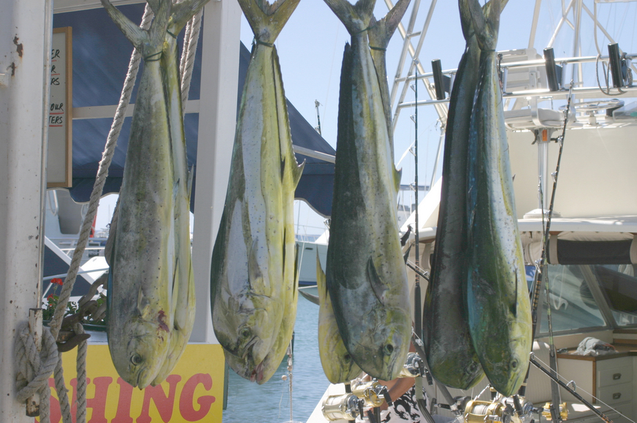
Over-fishing is when people take more fish from the ocean than the ocean can produce
Over-Fishing
Notes:
Over-fishing occurs when fishing activities reduce fish stocks below an acceptable level. The ability of nature to restore the fisheries depends on whether the ecosystems are in a state to allow fish numbers to build again. Over-fishing happens in many ways and for many reasons.

Slide 7
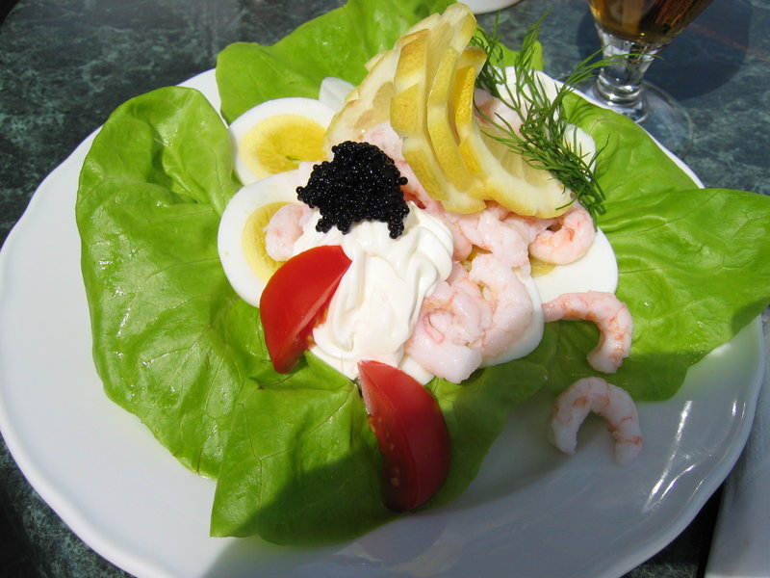
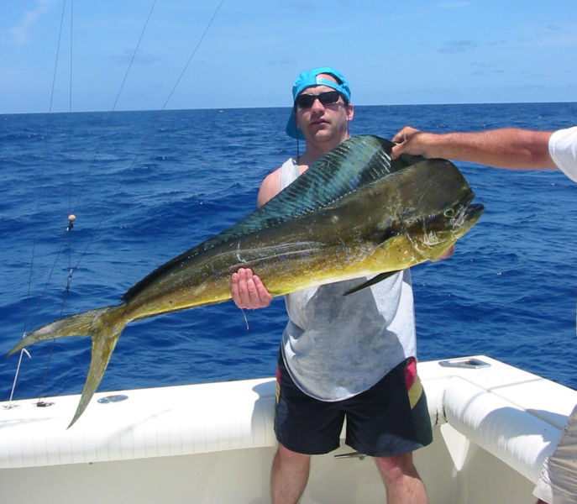
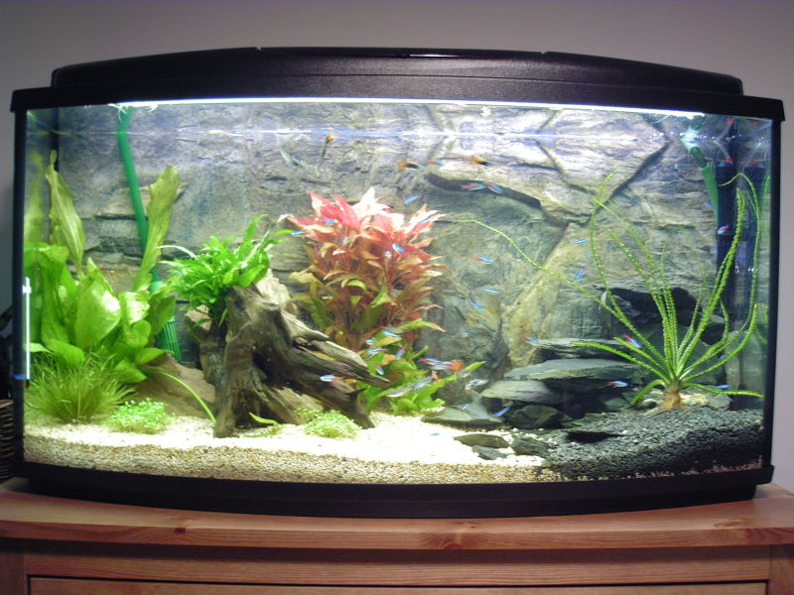
Why do people over-fish?
Over-Fishing
Food
Entertainment & Sport
Aquariums
Notes:
Most over-fishing stems from large commercial fleets that supply fish for consumption. The World Wildlife Federation reports that over a billion people rely on marine fish as an important source of protein. The entertainment, sport, and aquarium trades are often guilty of over-fishing as well. Many times, people will take fish whose stocks are already depleted simply to mount the fish on their wall or put it in an aquarium.

Slide 8
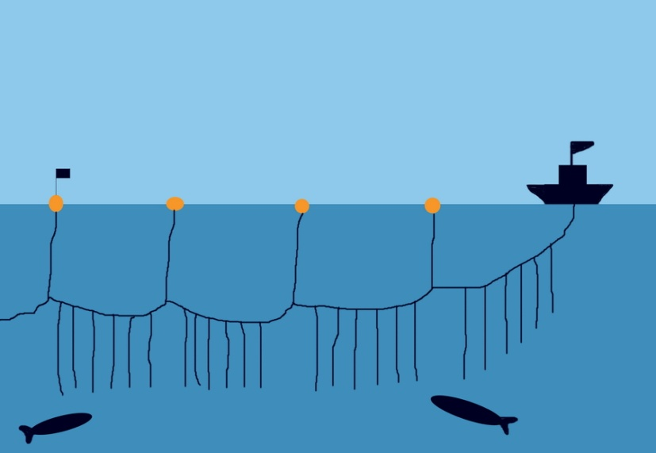
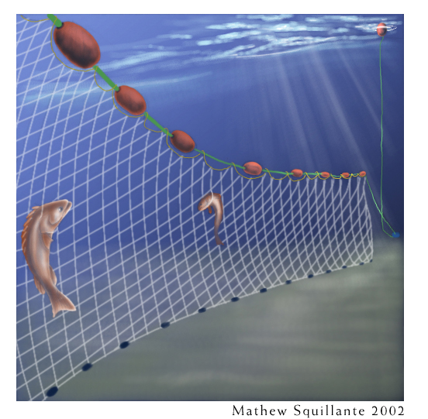
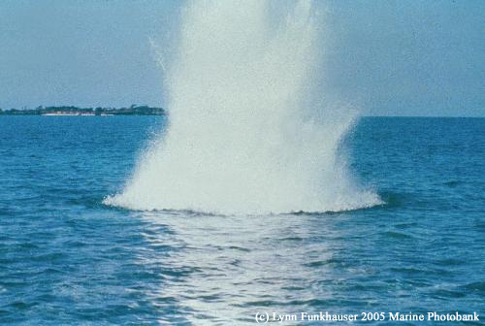
How do people over-fish?
Over-Fishing
longlines
Photo courtesy of Monterey Bay Aquarium Foundation
gillnets
dynamite & poisons
Notes:
New fishing vessel construction trends show more vessels are being built with technology that allows great numbers of fish to be taken. Longline fisheries have lines of up to 50,000 hooks to catch large amounts of fish with each set. Gillnets are a series of panels of meshes with a weighted “foot rope” along the bottom, and a “headline,” to which floats are attached. Gillnets often kill species of fish that the fisherman is not seeking. If the fisherman were to catch these fish by hook and line, he would release them. In a gillnet, they are dead or dying. Dynamite fishing kills fish by the shock waves from the blast. The fish are then skimmed off the surface or collected from the bottom by divers. These explosions not only kill large numbers of fish and other marine organisms in the vicinity, but they also destroy the physical structure of coral reefs. Poisoning is done by spraying poison such as cyanide or bleach around a coral to stun fish and make them easier to collect. The fish are gathered and packed into plastic bags and are mostly sold to aquariums. Unfortunately, many fish collected this way die in transport or have shorter life spans after being stunned by the poison.

Slide 9
Over-fishing threatens the coral reef habitat
Fish caught too young cannot grow old to reproduce and contribute to fish population
Fewer fish are available to provide food for other marine organisms
Some fish eat algae and where there are less of these fish, algae grows too thick and smothers the reef
Over-Fishing
Notes:
Overfishing can be a major pressure on coral reef systems, reducing levels of biodiversity and typically resulting in shifts in fish size, abundance, and species composition, altering the ecological balance on the reef. NOAA, in partnership with regional Fishery Management Councils and the fishing community, has banned the most damaging fishing practices in federal waters and is working to reduce overfishing. However, further advances are needed, especially within state waters, where most coral reefs and fishing occur.

Slide 10
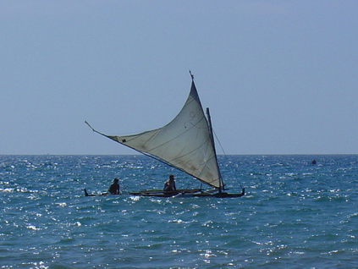
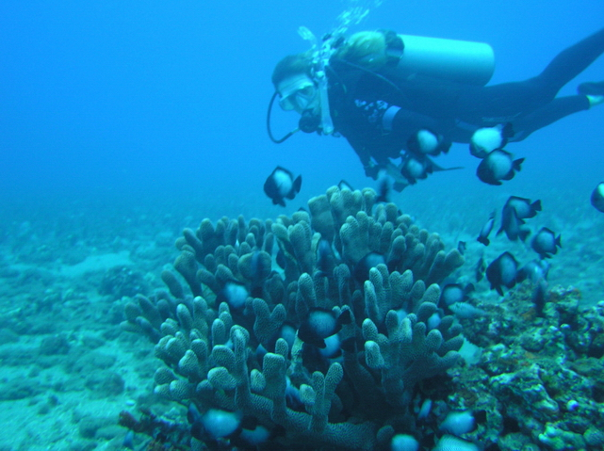
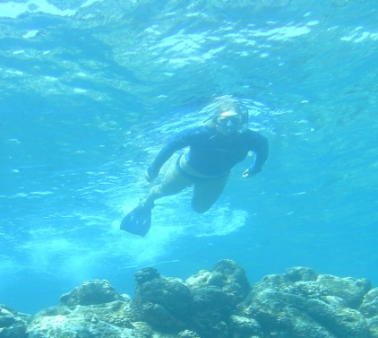
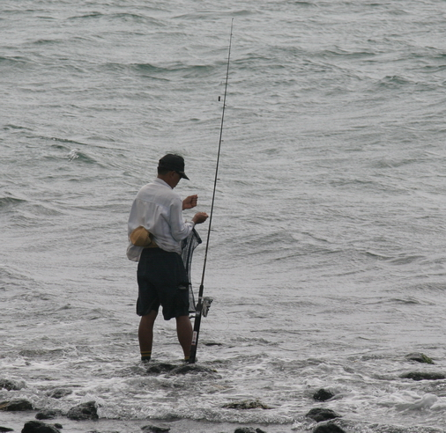
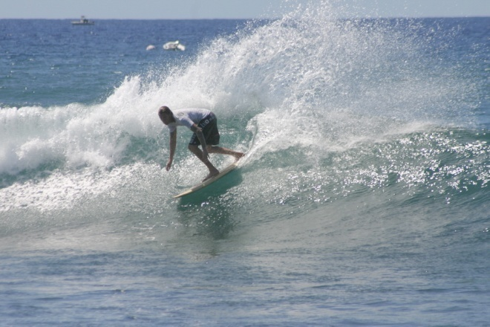
How do people use the reef for recreation?
Careless Recreation
boating
diving
snorkeling
surfing
fishing
Notes:
Coral reefs draws people of all backgrounds and ages. Different people use the reef for different reasons from boating and surfing, to snorkeling and diving, to fishing and other various forms of uses.

Slide 11
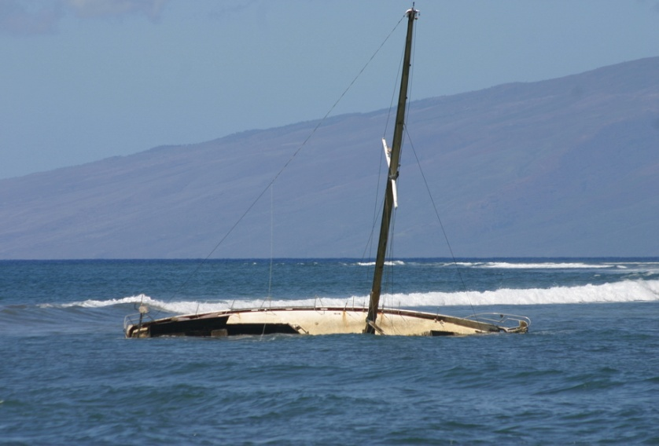
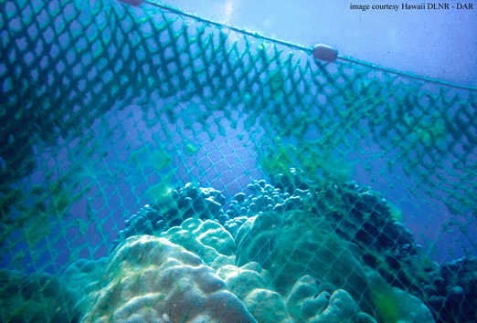
How are people careless with the reef?
Kicking, touching, or standing on coral
Boats can drop anchor or drive across shallow coral
Careless Recreation
Abandoning fishing gear
Notes:
Simply touching coral can kill the fragile polyps that make up a reef. A coral reef that took years to grow and multiply can be instantly broken off by a careless snorkeler or diver that stands on or bumps up against a coral head. Many boats that anchor over a reef can take out numerous coral heads simply by dragging an anchor across the reef. Abandoned fishing gear, often referred to as “ghost gear,” can land on coral reefs and kill it by smothering it or by breaking of pieces of coral as the ghost gear drifts with currents.

Slide 12
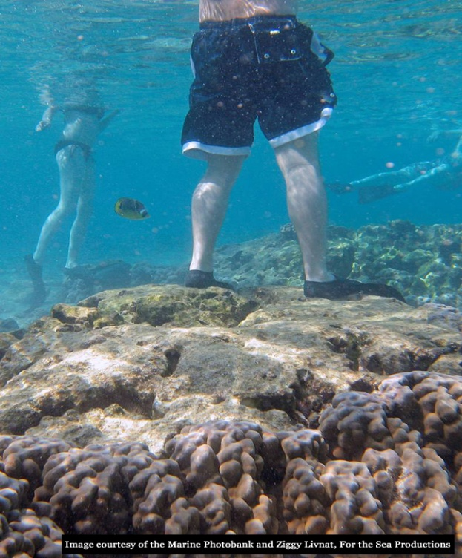
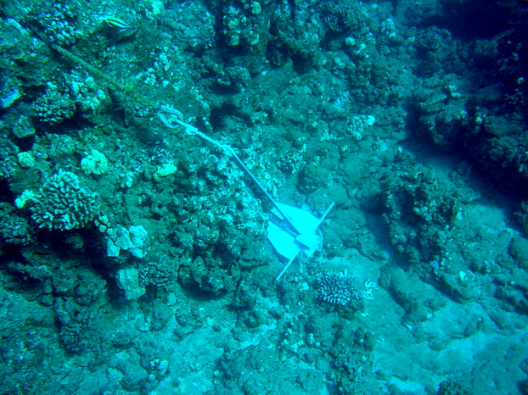
What can you do to protect the reef?
Don’t touch the coral or any other animals
Do not drive your boat over coral
Only drop anchors in sand or other non-coral sediment
Educate others!
Careless Recreation
Notes:
Many times, coral reefs are damage due to lack of knowledge or education by those who use it. We can educate others by kindly asking fellow snorkelers and divers not to touch the reef. We can also educate boat captains by explaining to them how an anchor can wipe out a coral reef and ask them to anchor only in sand or rock.

Slide 13
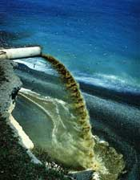
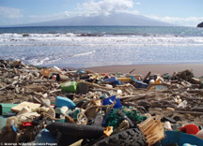
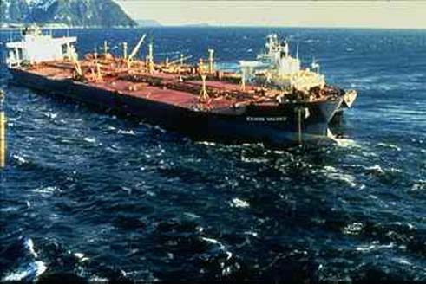
Pollution
Raw sewage
Trash that settles on coral will kill it
Human’s cause many forms of pollution that harms or kills coral.
Lost fishing gear (ghost gear)
Oil can kill all forms of sea life
Notes:
Although much less than in the past there is still places where raw sewage goes into the ocean. We generate a lot of trash which often ends up in the office and on the coral. An oil spill is a death sentence to any coral covered in it. We all need to do our part in not polluting.

Slide 14
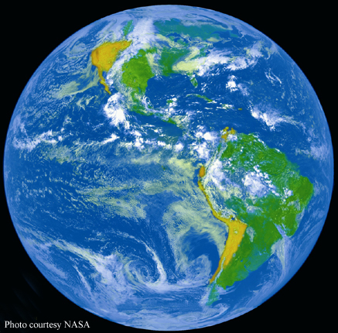
What is climate change?
Climate Change
Climate change is the increase in the temperature of the Earth’s air and oceans.
Notes:
Carbon dioxide and other gases warm the surface of the planet naturally by trapping solar heat in the atmosphere. This is a good thing because it keeps our planet habitable. However, by burning fossil fuels such as coal, gas and oil, and clearing forests we have dramatically increased the amount of carbon dioxide in the Earth’s atmosphere and temperatures are rising.

Slide 15
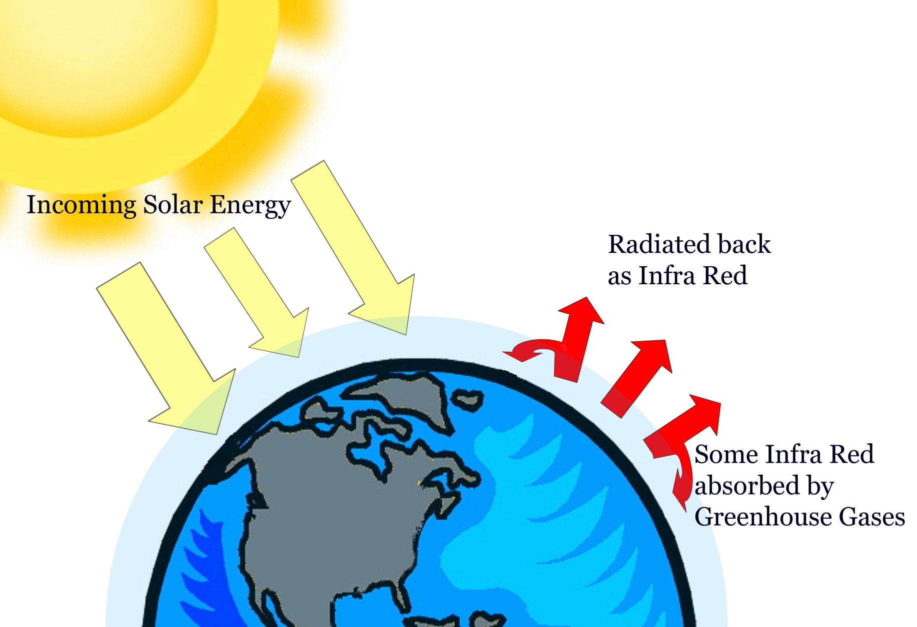
What causes climate change?
Climate Change
Climate Change happens when more carbon dioxide enters the atmosphere than can be removed by plants
Notes:
Evidence of climate change can been seen in a variety of ways: Heat waves and periods of unusually warm weather, ocean warming, sea-level rise and coastal flooding, glaciers melting, Arctic and Antarctic warming.
Events that foreshadow impacts with continued warming: Spreading disease, earlier spring arrival, plant and animal range shifts and population changes, coral reef bleaching, downpours, heavy snowfalls & flooding, droughts and fires

Slide 16
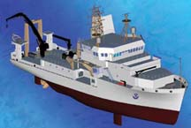
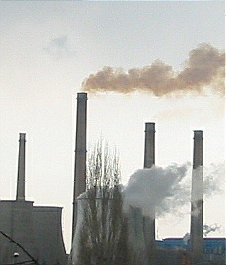
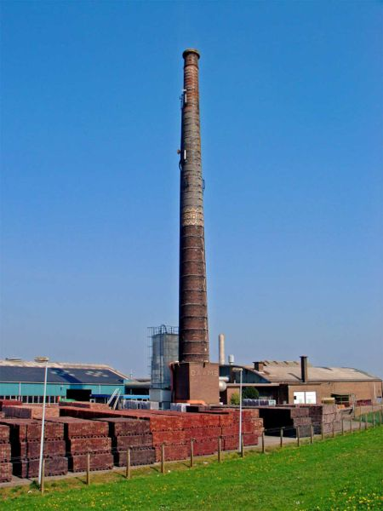
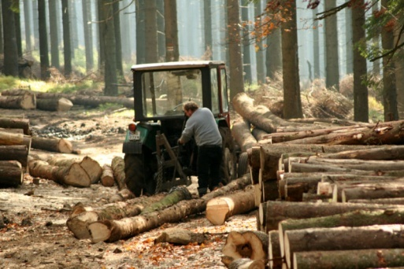
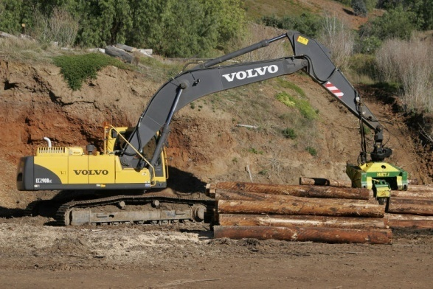
Human sources of climate change
many types of transportation
Climate Change
factories
deforestation
anything that uses fossil fuels!
Notes:
We need energy to do things like drive a car, fly a plane, or make things in factories. But we need to use energy wisely if we want to help slow climate change. Technologies exist today to make cars that run cleaner and burn less gas. Modernized power plants generate electricity from nonpolluting sources and cut our electricity use through energy efficiency.

Slide 17
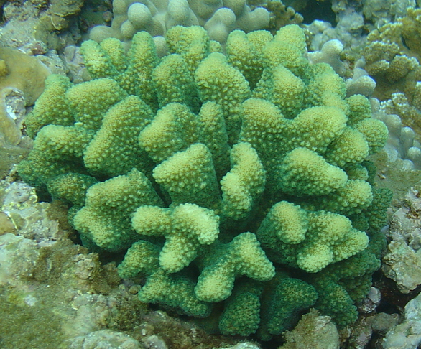
How does climate change affect the coral reef habitat?
Bleaching is a result of warm sea-surface temperatures
Climate Change
healthy coral
bleached coral
Increases in water temperature can kill marine organisms not adapted to the warmer temperatures
Notes:
Coral bleaching is the loss of color in corals dues to stress-induced expulsion of their symbiotic algae (zooxanthellae). Global climate change may play a role in the increase in coral bleaching events, and could cause the destruction of major reef tracts and the extinction of many coral species. In most instances wherever coral reef bleaching was reported, it occurred during the summer season or near the end of a drawn-out warming period.

Slide 18
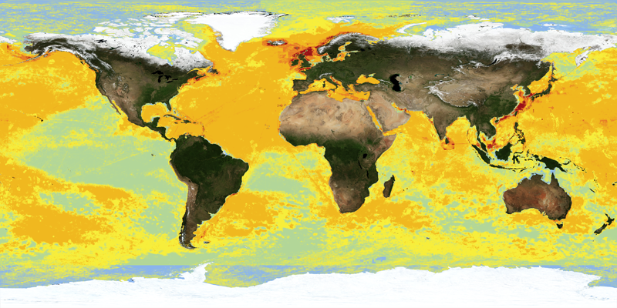
Human Impacts on the Ocean
The Big Picture
Notes:
This image shows the cumulative impacts of human activity on the oceans. Green represents areas with less impact, and red represents areas that experience much greater impact.
A study by Dr. Kenneth Casey in Feb 2008 , with NOAA's National Oceanographic Data Center, shows that 40% of the world's oceans are heavily affected by human activities like overfishing and pollution. The marine ecosystems most threatened by human activities are coral reefs.
The ocean impacts the lives of everyone on Earth, even those who do not live on or near the coast, and humans affect the ocean in a variety of ways. Individual and collective action is necessary to wisely manage ocean resources for all.
Which areas have been impacted the most?
What about the least?

Slide 19
The End

